Slide 1
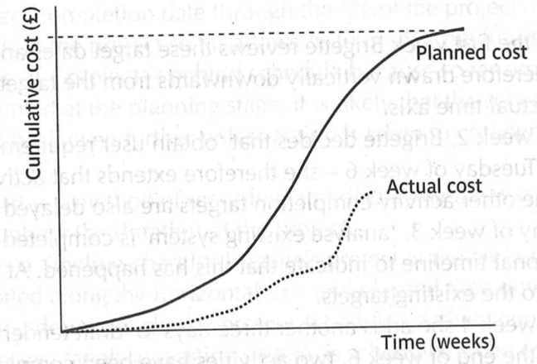
Planned Cost
Cumulative cost(¥)
Actual cost
Time(weeks)

Slide 2
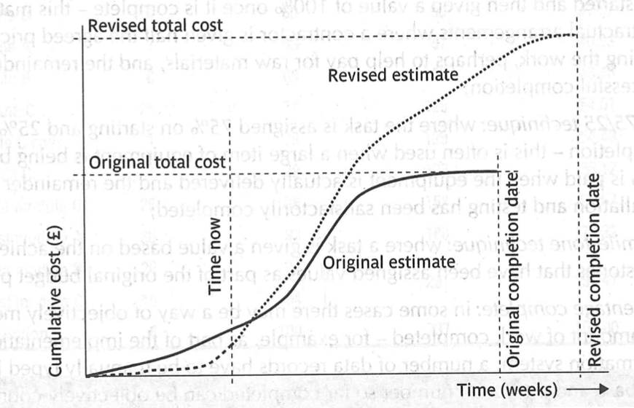
Revised total cost
Revised estimate
Cumulative cost(¥)
Original total cost
Original completion date
Time now
Revised completion date
Original estimate
Time(weeks)

Slide 3
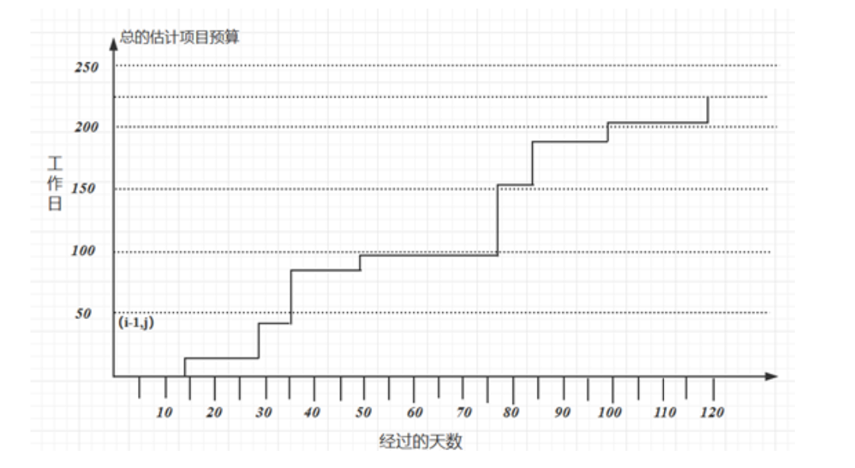
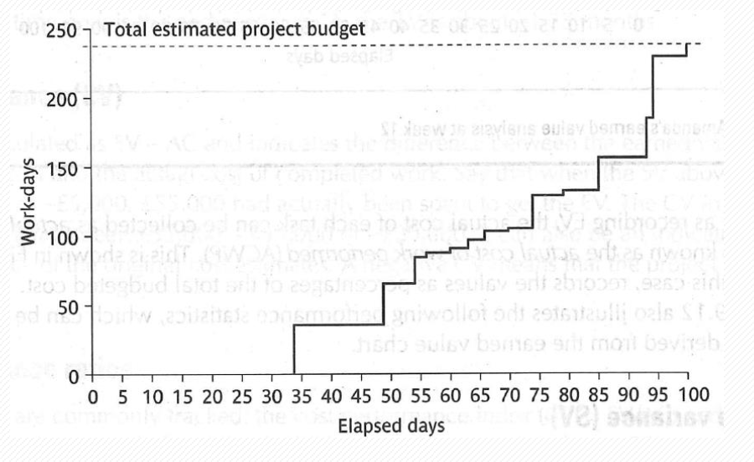
Total estimated project budget
200
150
Work-days
100
50
10
20
30
40
50
60
70
80
90
100
110
120
Elapsed days

